Slide 1

Prototype 1 Meeting 3/29/2021
Notes:
Oscar - This is the call to order/roll call/recognition of any guests (there's none) type out exactly what you will say so we can have a run through. This slide is basically the welcoming slide for the meeting as we wait for people to join.

Slide 2



Project Requirements & Specifications
Notes:
A user should be able to request an image given a location. (lat long coordinates or a street name)
This information should provide the user with a google street image as well its respective metadata.
A user interface should be prompted so that the user can query and see the image
We would like to feed this image into a machine learning algorithm to detect litter and calculate the score of that location
Store the image and respective metadata in a database

Slide 3
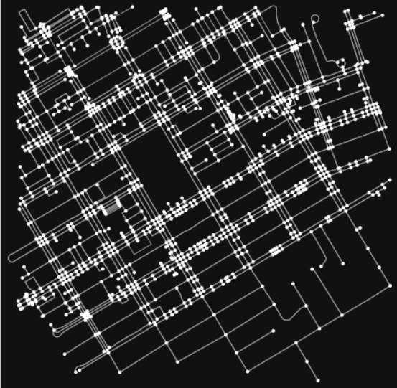
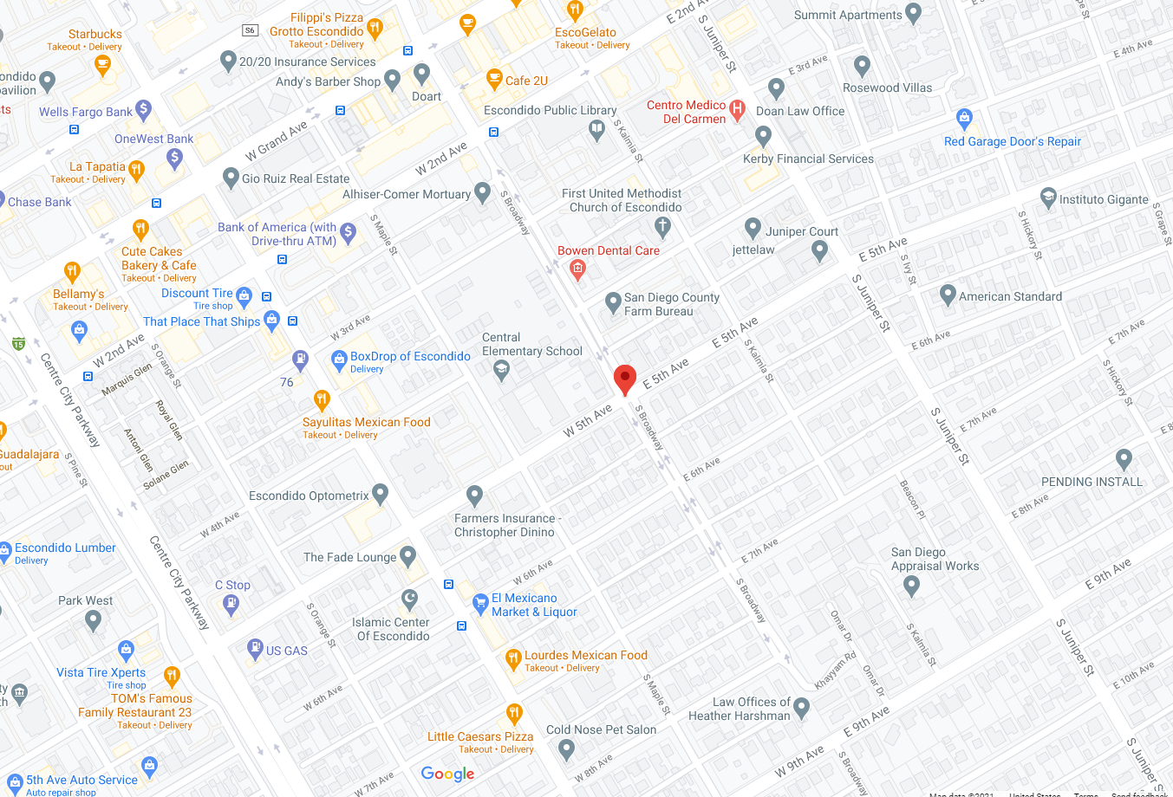
Initial Solution
OSMnx allows to model street networks
Provided useful in obtaining multiple points at intersections
only generated coordinates at each white node
Missed substantially large sections
Location = 33.118054, -117.078971 or E 5th Ave, Escondido, CA 92025
Notes:
Thank you Alex,
So our first attempt at creating a prototype involved implementing an open source python package called OSMnx. Its purpose is to create and model street networks of cities to download and this was suggested by the previous team. OSMnx allowed us to provide parameters to create networks of any size area. While this was useful in obtaining multiple coordinate points in a defined bounded box, the coordinate points were inconsistent in their placement and distance from one another. The image on the bottom left shows a network graph generated by OSMnx. This graph was generated with a single coordinate. The image on the right is a screenshot taken from Google Maps in the same place with the red marker as the parameter used to generate the left image. Now as you can see in the left image, the white dots are the nodes that OSMnx automatically generates and the white lines are the streets. Each node provided a corresponding coordinate of its location as well as other metadata. However OSMnx only keeps nodes at intersections to generate their networks, so this leaves a substantial amount of missing coordinates on streets with few intersections. These long streets have no nodes to obtain coordinate points from. While OSMnx provided an efficient method of obtaining metadata for a city we felt that it did not adequately cover all sections of streets to provide images.

Slide 4
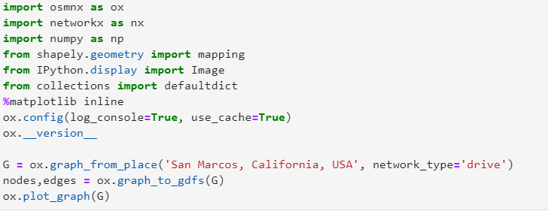
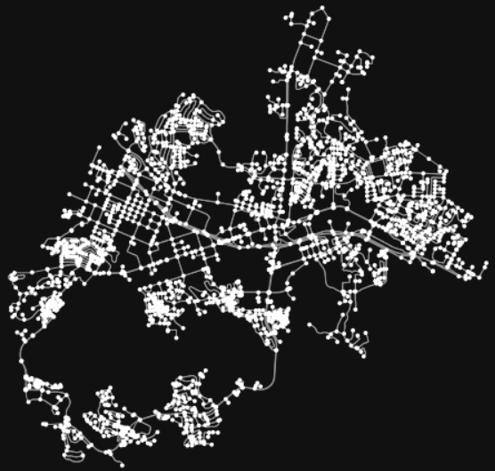
Notes:
This is just demonstrating that OSMnx could provide a network for the entire San Marcos area but as stated before the nodes and coordinates are limited to only intersections. The left image is a simple script demonstrating OSMnx’s use and the right is the graph the script generated. Now I will pass it to Arianna.

Slide 5

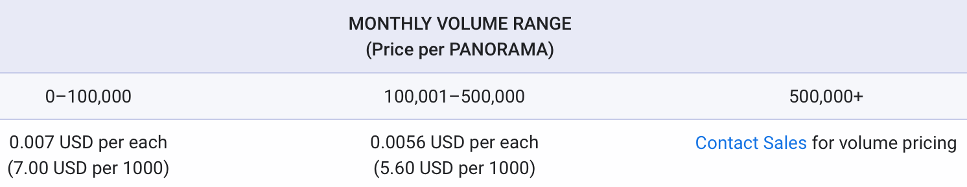
Second Solution
What is the Google Street View Static API
Cost = 0.007 USD for each Static Street View Panorama
70 USD per 10,000 panoramic images (within budget)
Metadata request is free of charge.
Required Parameters : location can be either a text string (such as Chagrin Falls, OH) or a lat/lng value (40.457375,-80.009353).
What is the “requests” Python Package
Notes:
Thank you Vinny,
After our first attempt trying to use OSMNx we quickly realized that osmnx was not of much use other than providing metadata about street intersections. Initially, we thought we could use this metadata to request a large set of google street images from the Google static API but we felt this was an unnecessary extra step and limiting us to the data that could be received. We want to directly obtain any image requested by working directly with the Google maps console served from the Google Street Maps API.
So what is Google Street View Static API? It is Google’s straightforward HTTP-based API for developers to access its massive collection of street-view panoramic images. The API can grant us access to a large collection of street view pictures given a location or a pair of coordinates. The service is relatively free when requesting only metadata, but .007 USD per panoramic image.
Being able to query the service enables us to create our own image-based modeling dataset that we aim to eventually feed to the machine learning algorithm. Another tool we heavily relied on was the requests python package, which is a simple HTTP library for Python users to fulfill these API requests sent to the API service. The response to these requests will be returned in JSON format which James and Vinny will further discuss in detail in the next slide.

Slide 6

Prototype 1 Presentation
Needs for the API:
Google Developer API Key
Parameters for location
Address ( 333 S. Twin Oaks Valley Rd, San Marcos, CA)
Latitude & Longitude (33.129128 , -117.159655)
Metadata (copyright, date, location; (lat, lng), pano_id, status)
Notes:
James if possible should be able to screen share and present the prototype.
Vinny:
32.707834, -117.160113
333 S Twin Oaks Valley Rd, San Marcos, CA 92096
12345 Fake Lane
Thank you James,
I will now show a demonstration of how our prototype script works.This script will prompt the user to enter either an address or a coordinate point. I will go ahead and run this script and I will input a coordinate first. At the bottom I am given a prompt and I will paste this coordinate. Now as the script ran it outputs the metadata that is free to request from. It shows the initial date, latitude and longitude, its unique pano ID, and a status. Now our status says OK meaning that the Google StreetView API can pull an image for this location. Once it says complete, the metadata is saved into a folder in a JSON file and the jpg image itself is also saved. This JSON file has the Date it was requested. And here is the image itself.
Now I will run this script again and use an address. The script will output the same information as this is a valid address. And here is the image.
Next I will try and input an invalid address. This time the status changed to Not Found. The script also outputs a message stating that the picture is not available. It did generate a JSON file but If i open it, it simply says the status was Not Found.
That is all for our demonstration, I will now pass it back to Arianna.

Slide 7
Prototype 1 Presentation

Slide 8

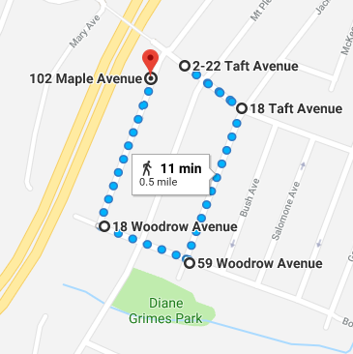


Future Enhancements
Fulfill multiple requests given a predefined range.
Provide a front end user interface with a simple design to display the data.
Connect to the database to save and store images/metadata
Notes:
Now that we can render any image given any location and coordinate, we need to figure out a method that will allow us to input a location and display multiple images that we can feed into the ML algorithm. After attempting to run the machine learning algorithm I got stuck when retracing the previous groups steps. AWS has updated their platform and a few of the important configurations the previous group did are no longer available, I was also not able to create an instance credential restrictions. I will keep working with Jason so that we can then utilize the machine in our next prototype.
Another future enhancement we will continue to work on is providing a front end user interface with a clean design so that the user does not have to see the script in the inner workings. It would have at the very least a search bar and a results page with the images rendered along with its metadata so that a user like Wes can access this website deployed by the EC2 server.
We still intend to work with the previous groups relational database and machine learning algorithms. Now it's a matter or utilizing our script appropriately to deliver our predefined “Nice to haves”.

Slide 9

Discussion
Questions about prototype
Feedback about prototype
Future improvements
Set up Report 3D meeting
Notes:
Oscar - add any images that prompt the client to ask further questions.

